Slide 1
Chapter 11 Internet of Things, Smart Cities, and 5G Mobile System

Slide 2
outline
Smart Cities and Internet of Things
5G Mobile System

Slide 3
Internet of Things, Smart Cities

Slide 4
Internet of Things (IoT)
IoT refers to a paradigm of communication in which the objects of everyday life will be equipped with microcontrollers, transceivers and protocol stacks, allowing them to communicate with one another in the world of internet.
Some examples of IoT objects are home appliances, surveillance cameras, monitoring sensors, displays, vehicles, and all sorts of electronic devices.

Slide 5
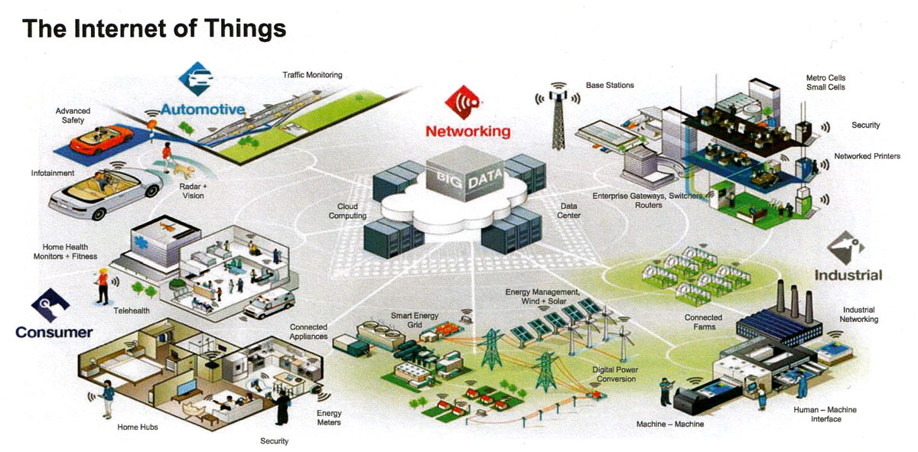
Internet of Things (IoT)
IoT in all aspects of our lives: home automation, industrial automation, medical aids, elderly assistance, energy management, traffic management and so on.

Slide 6
Urban IoT Architecture – A case study
IoT is a complex system with an enormous variety of application domains/scenarios and service requirements as well as massive amount of data.
Many different proposals and there is no single predominating standard.
Urban IoT architecture proposed in [1] was implemented in city of Pandova, Italy. It is discussed here as an illustration of the future IoT architecture.
[1] Andrea Zanella, et al, “Internet of things for smart cities”, IEEE Internet of things journal, vol. 1, no. 1, February 2014 , p22-32

Slide 7
Urban IoT Architecture – A case study
There are three major elements in the IoT architecture
Web Service Approach for IoT service
Link Layer Technologies
Devices

Slide 8
A. Web service approach
Web service architecture , similar to traditional web services, is both flexible and interoperable with other systems beyond IoT.
Unconstrained and constrained protocol stack:
Unconstrained: standards used by existing internet hosts, such as XML, HTTP and IPv4.
Constrained: tailored to the constrained, low-complexity IoT devices, standards including efficient XML interchange (EXI), the constrained application protocol (CoAP) and 6LoWPAN
Trancoding operations can be done easily between constrained and unconstrained protocols → easy, seamless adoption of IoT devices

Slide 9
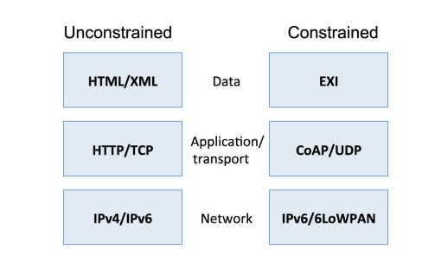
A. Web service approach

Slide 10
A. Web service approach
More on the constrained protocol stack:
Data formats: using EXI → smaller message sizes , simple message parsing
Application and Transport Layers: CoAP – a binary format (instead of human-readable format in HTTP) transported over UDP . It is interoperable with HTTP.
Network Layer: 6LoWPAN – compression format for IPv6 and UDP header for constrained networks. Require IPv4/IPv6 conversion (e.g. Universal Resource Identifier Mapping involving a HTTP-CoAP cross proxy)

Slide 11
B. Link Layer Technologies
Unconstrained technologies:
LAN, MAN, WAN, ethernet , WiFi, 4G (LTE) mobile
Constrained technologies
IEEE 802.15.4, Bluetooth, IEEE 802.11 Low Power, NFC and RFID

Slide 12
C. Devices
Backend servers
In the control center, data are collected, stored and processed to produced add-valued services
Database management
Websites
Enterprise resource planning (ERP)
Gateways:
Interconnect the end devices to the main communication infrastructure
Provide protocols translation and functional mapping
IoT Peripheral Nodes:
Powering mode, networking node, sensor. Supported link layer technologies
RFID tags, mobile devices, tablets, laptop, etc
Mobile devices can connect to IoT devices through internet, NFC, bluetooth, WifI, etc.

Slide 13
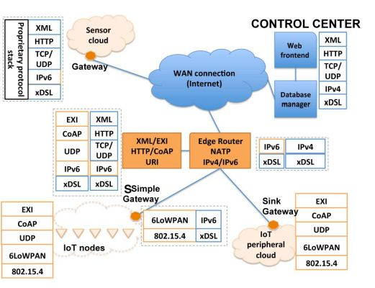
IoT Architecture

Slide 14
Smart City
In Smart City, the aim is to “make a better use of the public resources, increasing the quality of the services offered to the citizens, while reducing the operational costs of the public administrations” [1].
IoT is the major building block of the Smart City.

Slide 15
Internet of Things (IoT) and Smart City
To realize Smart City, a new infrastructure comprising of IoT, heterogeneous wired/wireless networks, intelligent data computing and storage facilities is required.
E.g. european smart cities project (http://www.smart-cities.eu)

Slide 16
Smart City – Case Study
Use the case study (Pandova , Italy) as illustration of a typical smart city and its various services.
There are eight major service areas:
Structural health – monitor the actual conditions of many historic building
Waste management – use of intelligent waste containers, optimization of truck routes, etc.
Air quality monitoring – find the healthiest place/path for outdoor activities
Noise monitoring – reduce noise, improve security
Traffic congestion – sensors on roads, vehicles
City Energy consumption – identify the main consumption sources (e.g. heating , cooling)
Smart parking – best path for parking in the city
Smart lighting – optimize street lamp intensity
Automation and salubrity of public building – control lights, temperature, and humidity in public environment

Slide 17
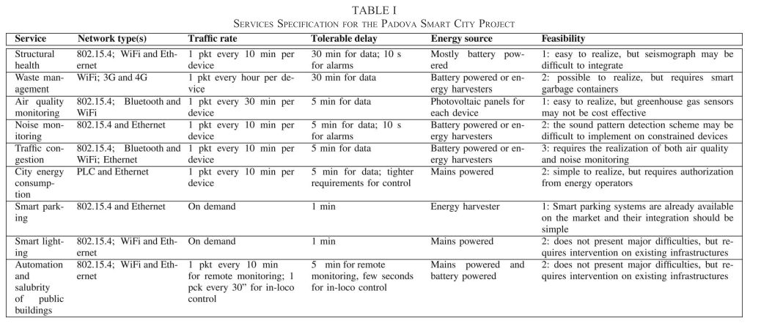
Smart City – Case Study

Slide 18
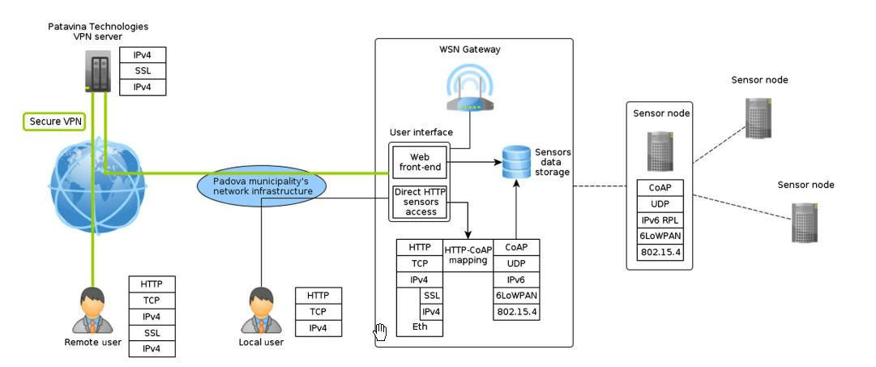
Smart City – Case Study

Slide 19
5G Mobile System

Slide 20
5G main objectives
10 Gbps speed and <10 ms latency
International Telecommunication Union (ITU) has classified 5G mobile network services into three categories:
Enhanced Mobile Broadband (eMBB) – focuses on services with high requirements for bandwidth, such as HD video, VR , and augmented reality (AR)
Ultra-reliable and Low-latency Communications (uRLLC) – focuses on latency-sensitive services, such as assisted and automated driving, remote management
Massive Machine Type Communications (mMTC) -- high connection density such as smart city, IoT

Slide 21
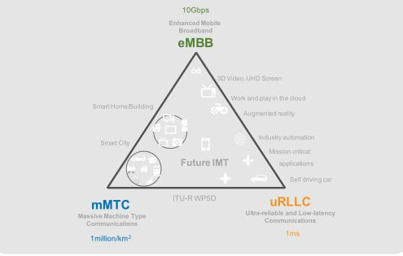
5G main objectives (according to ITU)

Slide 22
5G key technologies
Extreme densification and offloading
Small cells
Heterogeneous networks – 5G, LTE, 4G, Wifi, M2M
Biasing -- Offloading – pushing users off of the heavily-loaded macrocell and onto the lightly loaded small cells
Blanking -- Shutting off the macrocell transmissions for some fraction of the time, while the biased small cell users are being served.
Millimeter wave (30-300GHz)
Need LOS , very short range transmission , susceptible to blockages, rain absorption
Phantom cell (payload data in small-cell, while control plane operate at microwave frequencies from macro BS.

Slide 23
5G KEY technologies
Massive MIMO
Enormous enhancement in spectral efficiency
Smoothed out channel responses
Simple transmit/receive structures because of the quasi-orthogonal nature of the channels between each BS and the set of actives users.

Slide 24
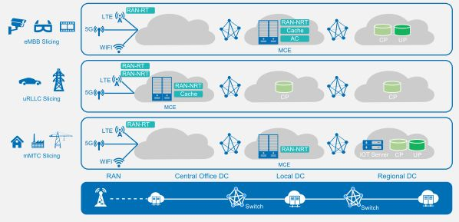
5G KEY technologies
Conceptual View of Network Slicing
eMBB (high bandwidth requirement) – deploy cache in the MCE of a local DC (close to users)
uRLLC (latency requirement) – deploy MCE on sites
mMTC – deploy MCE in local and regional DC
Notes:
CloudRAN consists of sites and mobile cloud engines.
MCE (Mobile Cloud Engine)
CP (control plane)

Slide 25
5G KEY technologies
Network Slicing
Tailor a set of functions to optimize use of the network for each mobile device
All of the functionality needed, only those needed, is assembled in a way that optimizes that device’s ability to access the network with a set of functionality needed by the device.
A simple device (IoT), for example a water meter reader- requires only access to a single slice.
A complex device (e.g. mobile phone) can access a diverse set of network slices that each tailored to a specific purpose: streaming video, voice calls, internet browsing.
All network-related functionality are accessed by APIs , VNFs that can be easily invoked and assembled to a slice and optimize use for each device.
Notes:
VNF (Virtual Network Function)
RAN (Radio Access Network)

Slide 26
KEY technologies
More on Network Slicing
Each network slice should have access to different types of resources, such as VPNs, cloud services and access , and the core network in the form of VNFs.
A full separation of control plane and user plane
Control and user-plane resources be scaled independently.
Data functions may increase without affecting the control plane functions.
Decomposition of the user plane into smaller functions
User-plane resources can be dynamically configured to serve additional services.
Support for migration to cloud-based deployments.

Slide 27
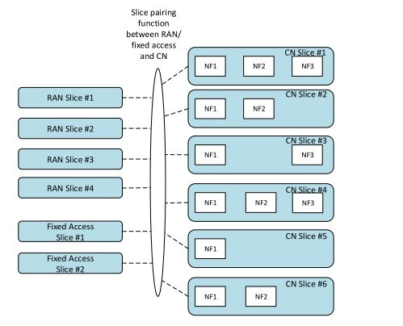
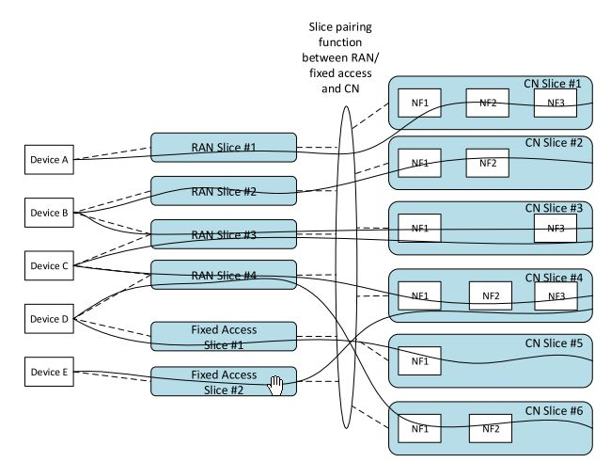
5G KEY technologies
Network Slicing Architecture
Architecture consists of access slices, core network (CN) slices and the election function
Examples of network slices: A slice serving a utility company, a slice serving a virtual operator, a slice optimized for streaming radio

Slide 28
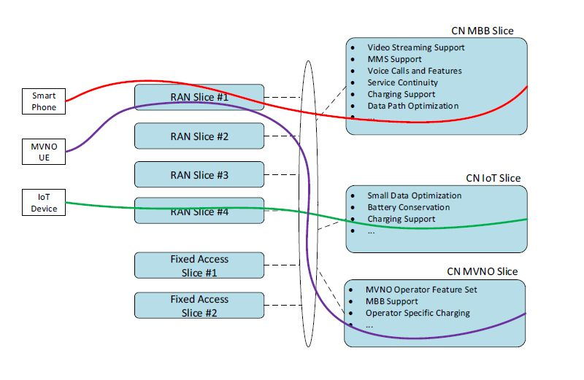
5G KEY technologies
Slice Examples

